Slide 1
Probabilistic classifiers
Biplab Banerjee

Slide 2
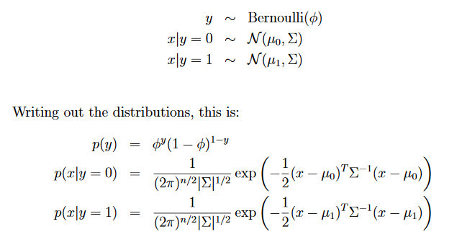
Gaussian discriminant analysis

Slide 3
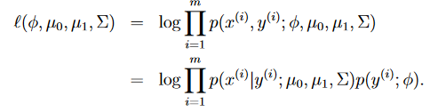
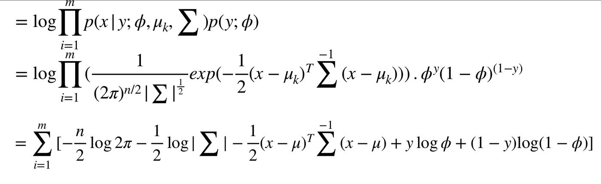
MLE estimation of the parameters

Slide 4
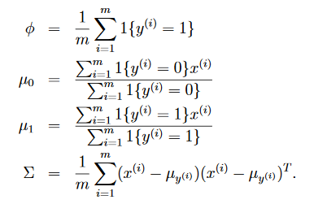

Slide 5
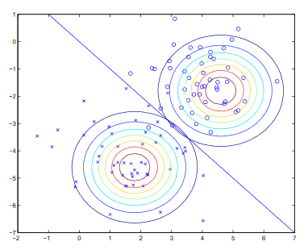
Gaussian discriminant analysis

Slide 6
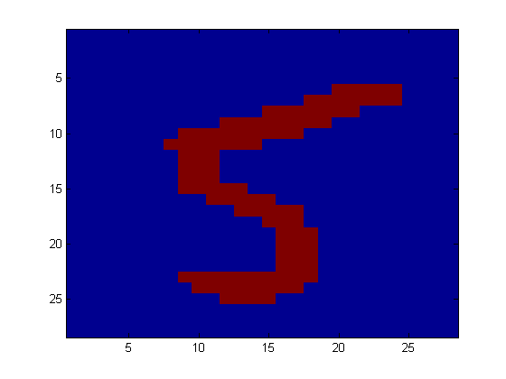
Naïve Bayes
Digit Recognition
X₁,…,X_{n} ∈ {0,1} (Black vs. White pixels)
Y ∈ {5,6} (predict whether a digit is a 5 or a 6)
Classifier
5

Slide 7

The Bayes Classifier
A good strategy is to predict:
(for example: what is the probability that the image represents a 5 given its pixels?)

Slide 8
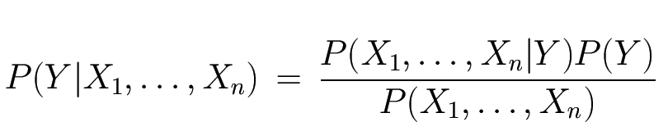
The Bayes Classifier
Use Bayes Rule!
Likelihood
Prior
Normalization Constant

Slide 9
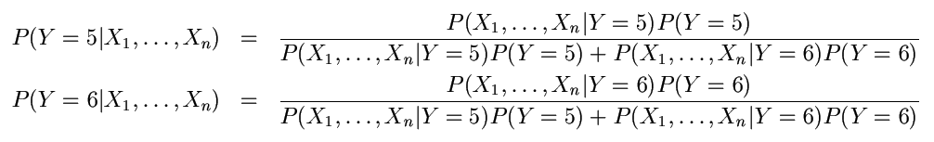
The Bayes Classifier
Let’s expand this for our digit recognition task:
To classify, we’ll simply compute these two probabilities and predict based on which one is greater

Slide 10
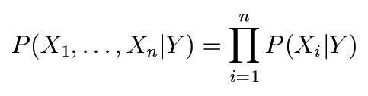
The Naïve Bayes Model
The Naïve Bayes Assumption: Assume that all features are independent given the class label Y
Equationally speaking:
(We will discuss the validity of this assumption later)

Slide 11
Why is this useful?
# of parameters for modeling P(X₁,…,X_{n}|Y):
2(2^{n}-1)
# of parameters for modeling P(X₁|Y),…,P(X_{n}|Y)
2n

Slide 12
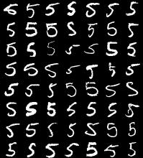
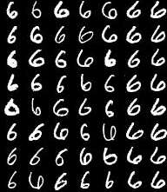
Naïve Bayes Training
Now that we’ve decided to use a Naïve Bayes classifier, we need to train it with some data:
MNIST Training Data

Slide 13
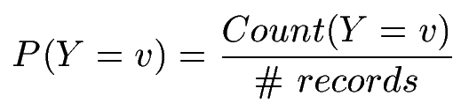

Naïve Bayes Training
Training in Naïve Bayes is easy:
Estimate P(Y=v) as the fraction of records with Y=v
Estimate P(X_{i}=u|Y=v) as the fraction of records with Y=v for which X_{i}=u
(This corresponds to Maximum Likelihood estimation of model parameters)

Slide 14
Nave-Bayes with Many-fields
P34 level | P61 level | BMI | Prostate cancer
High | Low | Medium | Y
Medium | Low | Medium | Y
Low | Low | High | Y
Low | High | Low | N
Low | Low | Low | N
Medium | Medium | Low | N
High | Low | Medium | Y
High | Medium | Low | N
Low | Low | High | N
Medium | High | High | Y

Slide 15
Nave-Bayes with Many-fields
P34 level | P61 level | BMI | Prostate cancer
High | Low | Medium | Y
Medium | Low | Medium | Y
Low | Low | High | Y
Low | High | Low | N
Low | Low | Low | N
Medium | Medium | Low | N
High | Low | Medium | Y
High | Medium | Low | N
Low | Low | High | N
Medium | High | High | Y
New patient:
P34=M, P61=M, BMI = H
Best guess at cancer field ?

Slide 16
Nave-Bayes with Many-fields
P34 level | P61 level | BMI | Prostate cancer
High | Low | Medium | Y
Medium | Low | Medium | Y
Low | Low | High | Y
Low | High | Low | N
Low | Low | Low | N
Medium | Medium | Low | N
High | Low | Medium | Y
High | Medium | Low | N
Low | Low | High | N
Medium | High | High | Y
New patient:
P34=M, P61=M, BMI = H
Best guess at cancer field ?
which of these gives the
highest value?
P(p34=M | Y) × P(p61=M | Y) × P(BMI=H |Y) × P(cancer = Y)
P(p34=M | N) × P(p61=M | N) × P(BMI=H |N) × P(cancer = N)

Slide 17
Nave-Bayes with Many-fields
P34 level | P61 level | BMI | Prostate cancer
High | Low | Medium | Y
Medium | Low | Medium | Y
Low | Low | High | Y
Low | High | Low | N
Low | Low | Low | N
Medium | Medium | Low | N
High | Low | Medium | Y
High | Medium | Low | N
Low | Low | High | N
Medium | High | High | Y
New patient:
P34=M, P61=M, BMI = H
Best guess at cancer field ?
which of these gives the
highest value?
P(p34=M | Y) × P(p61=M | Y) × P(BMI=H |Y) × P(cancer = Y)
P(p34=M | N) × P(p61=M | N) × P(BMI=H |N) × P(cancer = N)

Slide 18
Nave-Bayes with Many-fields
P34 level | P61 level | BMI | Prostate cancer
High | Low | Medium | Y
Medium | Low | Medium | Y
Low | Low | High | Y
Low | High | Low | N
Low | Low | Low | N
Medium | Medium | Low | N
High | Low | Medium | Y
High | Medium | Low | N
Low | Low | High | N
Medium | High | High | Y
New patient:
P34=M, P61=M, BMI = H
Best guess at cancer field ?
which of these gives the
highest value?
P(p34=M | Y) × P(p61=M | Y) × P(BMI=H |Y) × P(cancer = Y)
P(p34=M | N) × P(p61=M | N) × P(BMI=H |N) × P(cancer = N)

Slide 19
Nave-Bayes with Many-fields
P34 level | P61 level | BMI | Prostate cancer
High | Low | Medium | Y
Medium | Low | Medium | Y
Low | Low | High | Y
Low | High | Low | N
Low | Low | Low | N
Medium | Medium | Low | N
High | Low | Medium | Y
High | Medium | Low | N
Low | Low | High | N
Medium | High | High | Y
New patient:
P34=M, P61=M, BMI = H
Best guess at cancer field ?
which of these gives the
highest value?
P(p34=M | Y) × P(p61=M | Y) × P(BMI=H |Y) × P(cancer = Y)
P(p34=M | N) × P(p61=M | N) × P(BMI=H |N) × P(cancer = N)

Slide 20
Nave-Bayes with
P34 level | P61 level | BMI | Prostate cancer
High | Low | Medium | Y
Medium | Low | Medium | Y
Low | Low | High | Y
Low | High | Low | N
Low | Low | Low | N
Medium | Medium | Low | N
High | Low | Medium | Y
High | Medium | Low | N
Low | Low | High | N
Medium | High | High | Y
New patient:
P34=M, P61=M, BMI = H
Best guess at cancer field ?
which of these gives the
highest value?
P(p34=M | Y) × P(p61=M | Y) × P(BMI=H |Y) × P(cancer = Y)
P(p34=M | N) × P(p61=M | N) × P(BMI=H |N) × P(cancer = N)

Slide 21
Nave-Bayes with Many-fields
P34 level | P61 level | BMI | Prostate cancer
High | Low | Medium | Y
Medium | Low | Medium | Y
Low | Low | High | Y
Low | High | Low | N
Low | Low | Low | N
Medium | Medium | Low | N
High | Low | Medium | Y
High | Medium | Low | N
Low | Low | High | N
Medium | High | High | Y
New patient:
P34=M, P61=M, BMI = H
Best guess at cancer field ?
which of these gives the
highest value?
0.4 × 0 × 0.4 × 0.5 = 0
0.2 × 0.4 × 0.2 × 0.5 = 0.008

Slide 22
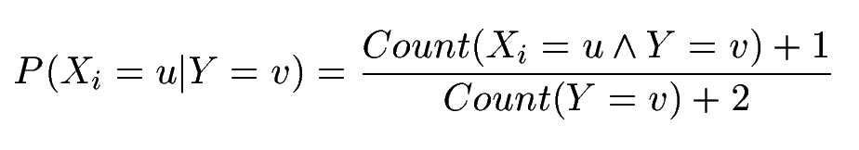
Naïve Bayes Training
In practice, some of these counts can be zero
Fix this by adding “virtual” counts:
(This is like putting a prior on parameters and doing MAP estimation instead of MLE)
This is called Smoothing

Slide 23
In practice, we finesse the zeroes and use logs: (note: log(A×B×C×D×…) = log(A)+log(B)+ …)
P34 level | P61 level | BMI | Prostate cancer
High | Low | Medium | Y
Medium | Low | Medium | Y
Low | Low | High | Y
Low | High | Low | N
Low | Low | Low | N
Medium | Medium | Low | N
High | Low | Medium | Y
High | Medium | Low | N
Low | Low | High | N
Medium | High | High | Y
New patient:
P34=M, P61=M, BMI = H
Best guess at cancer field ?
which of these gives the
highest value?
log(0.4) + log (0.001) + log(0.4) + log(0.5) = -4.09
log(0.2) + log (0.4) + log(0.2) + log(0.5) = -2.09

